Slide 1
SRM Yearbook
A dynamic web application made for 15IT304J- Web Programming
Team Details
Madhuri Rudrabhatla(RA1711003010263)
Saumya Awasthi(RA1711003010233)
Submitted To: Ms S Kanmani

Slide 2
Introduction
SRM yearbook is a dynamic web application which allows graduating students to create a memoir of their academic, and other highlights of their college life.
Fuctionalities:
Add/ Create your profiles
Edit/Modify your profile at any time
View Other Batchmates’ profile
Added User security (others cannot modify/delete your profile)

Slide 3
Technologies used
Client Side
Front End Views- Html, CSS
Form Validation, Custom Functionality: Javascript
Server side
Form validation: PHP
Session handling, redirections: PHP
Database Connection: PHP PDO library
Database used: MYSQL (ADMINER)
Web Server: Apache

Slide 4
Implementation – Client Side
Html:
Semantic tags: head, body, header, div, footer – used to do sectioning of the webpage.
Script tag used to insert JS
Link rel used to link css stylesheet
Html tables Used to display User Data (summarised) <table>, <th>, <td>

Slide 5
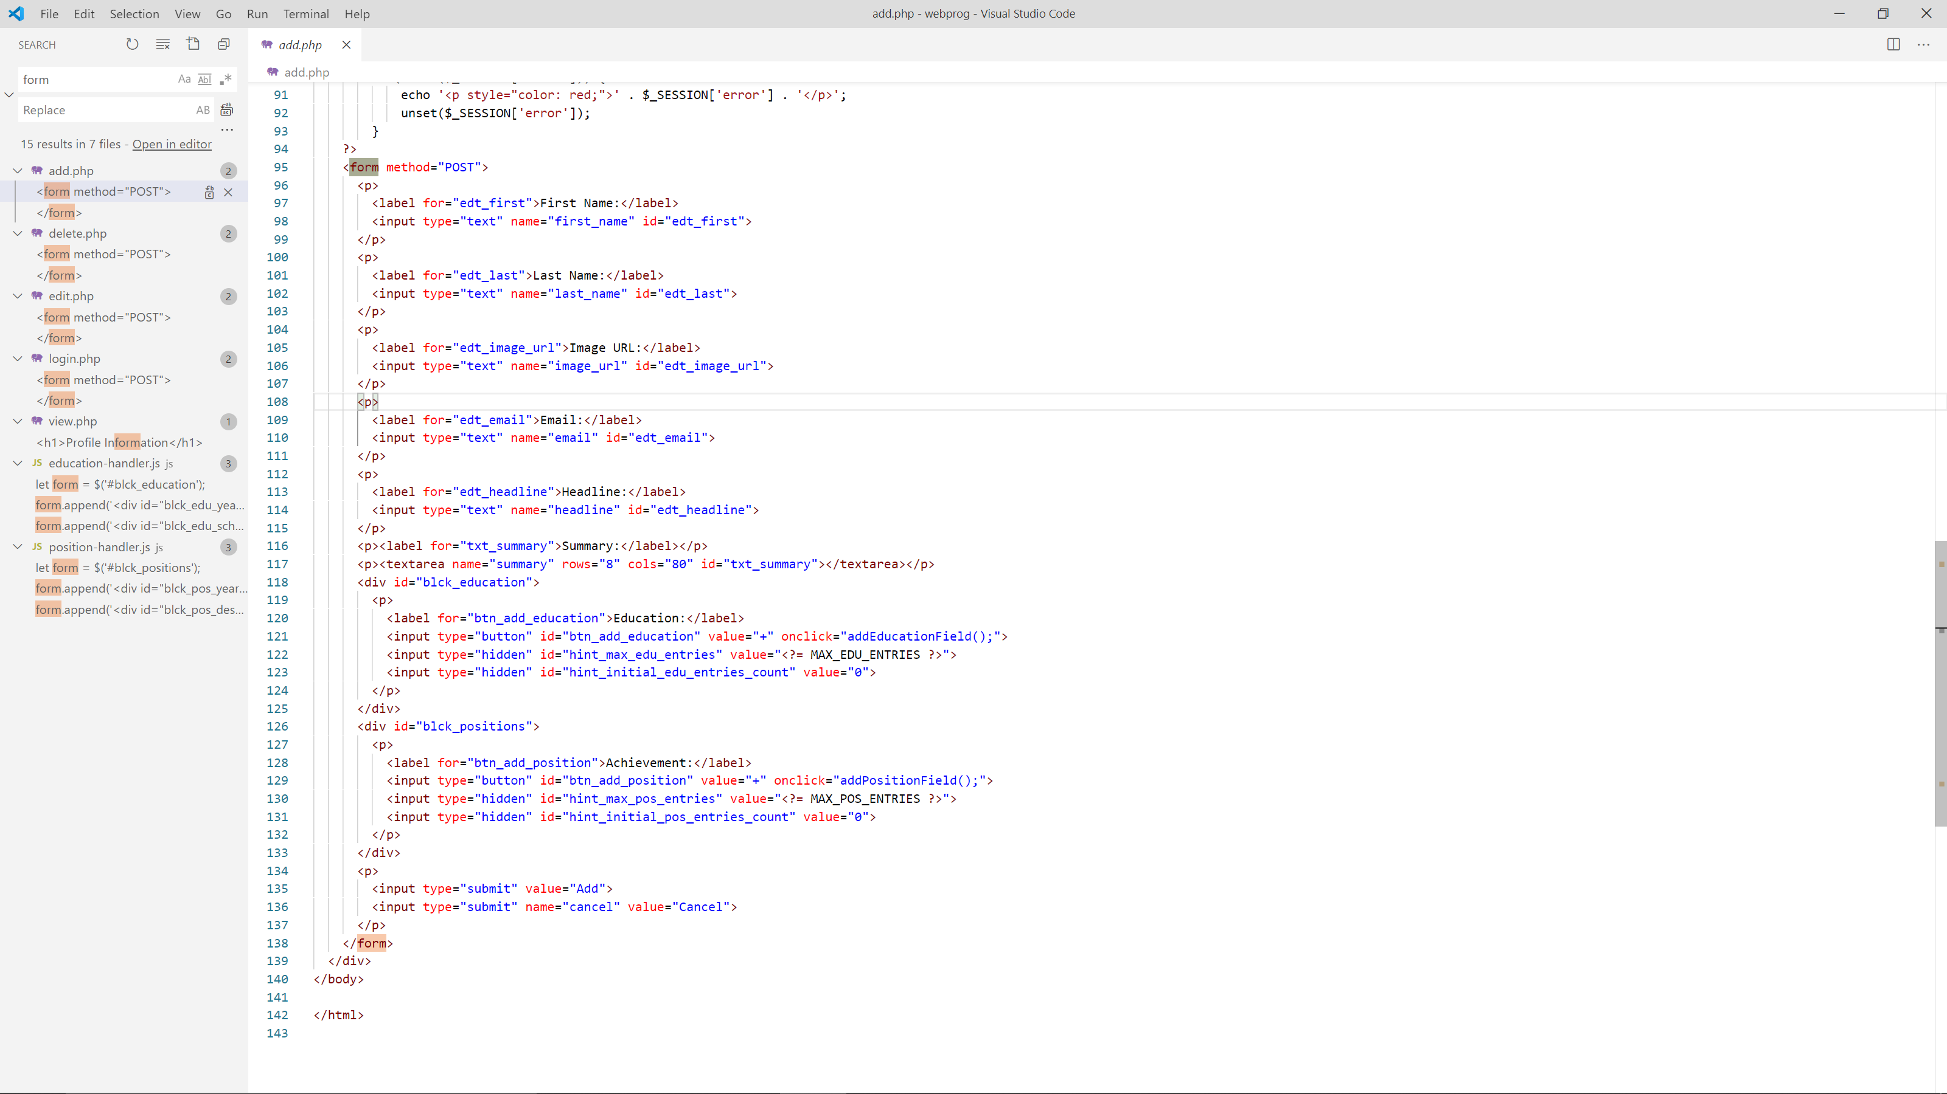
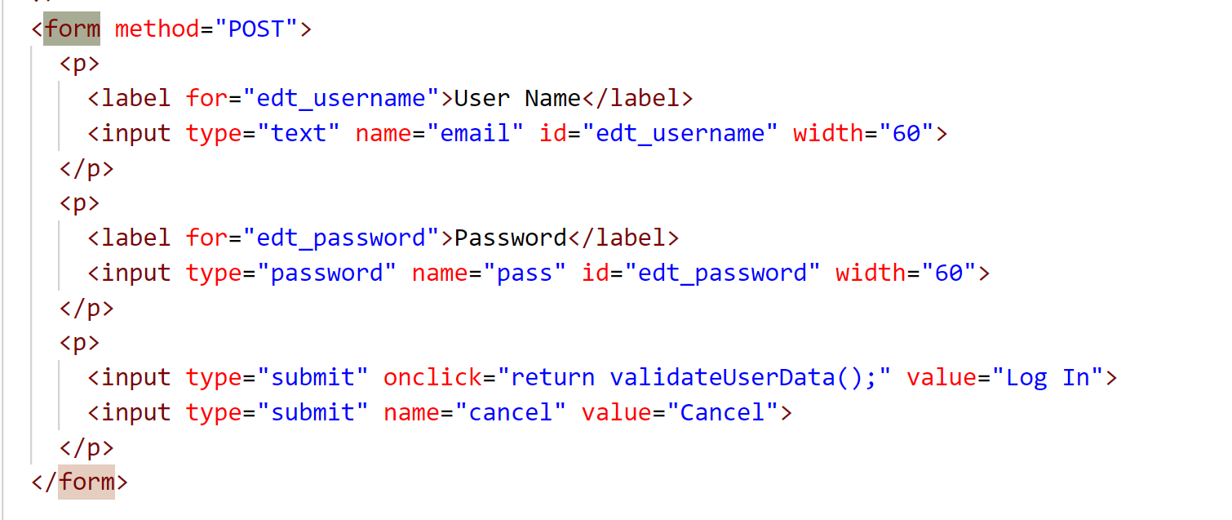
Html Forms

Slide 6
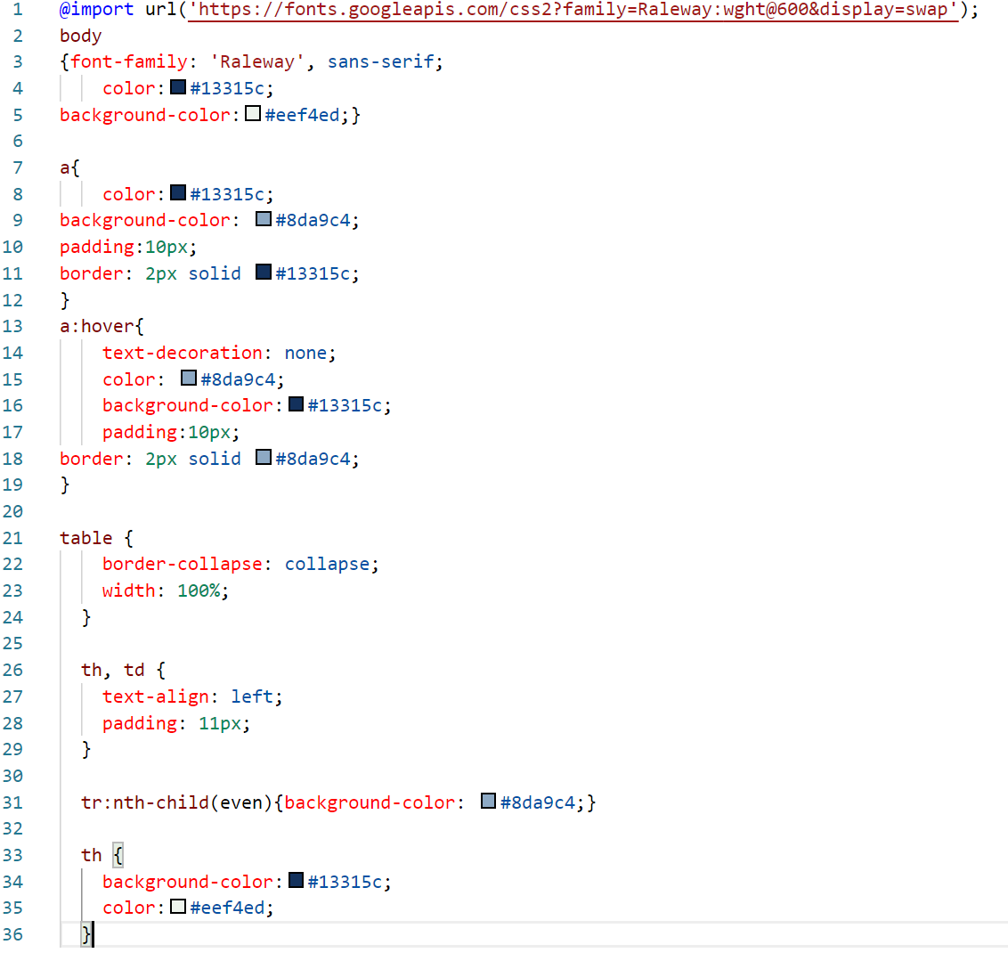
CSS
Css styling has been done to apply a common color theme to the different pages, to add spacing between DOM elements and to style the html tables
Font, background, color, used to style the overall page
Padding, border, text-decoration used to convert links into buttons
Table, th, td, used for table styling
Tr:nth- child (even)- CSS Selectors- used for adding striped pattern to table for better viewing.

Slide 7
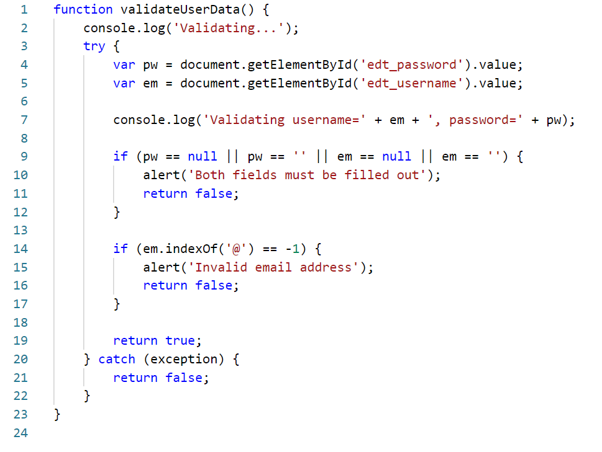
Javascript
Javascript has been used for 2 functions in this application:Client Side Form validation and custom functions.
Form Validation

Slide 8
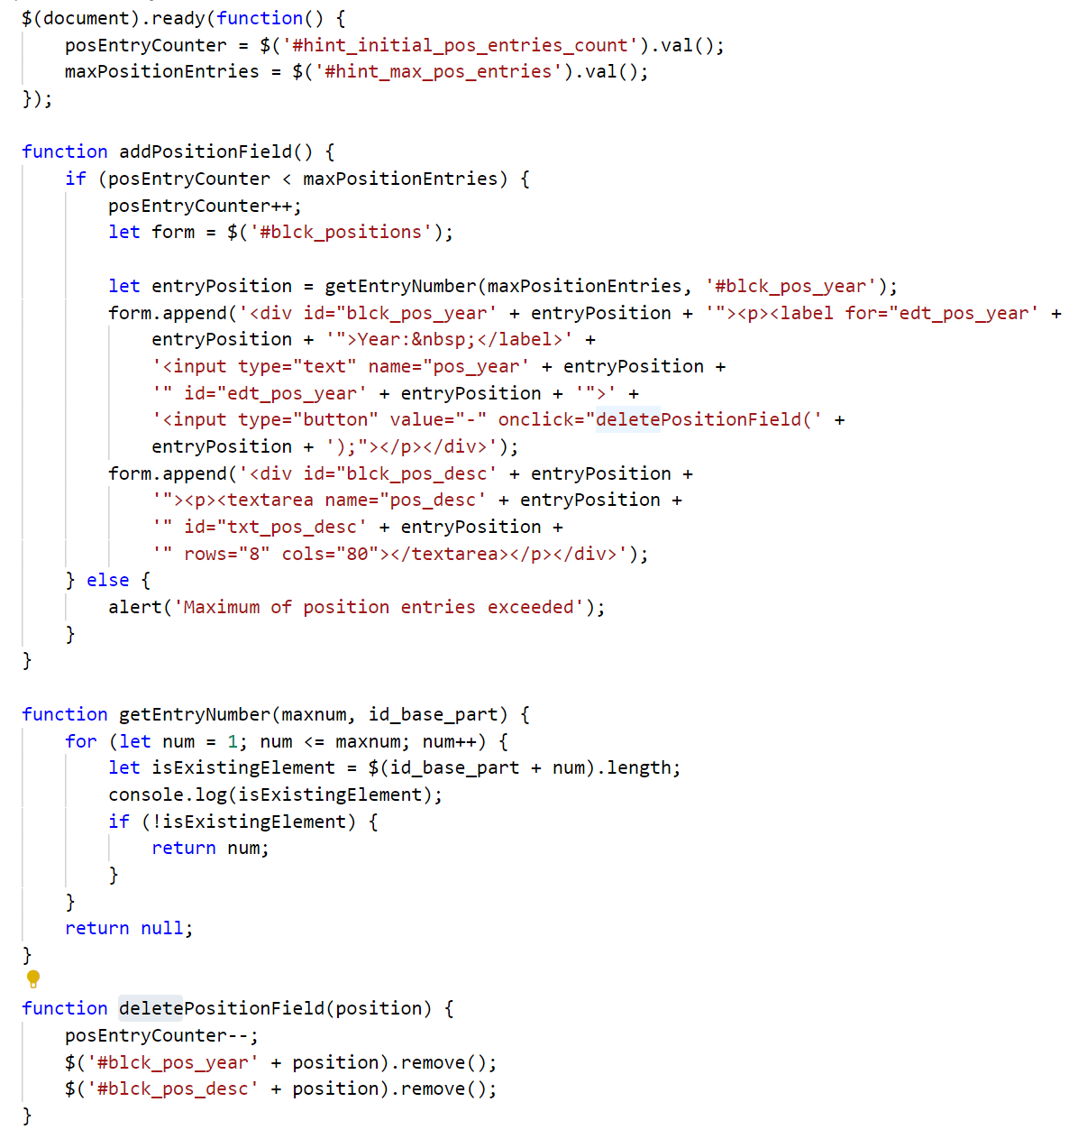
Custom functions in JS – Dynamic Forms

Slide 9
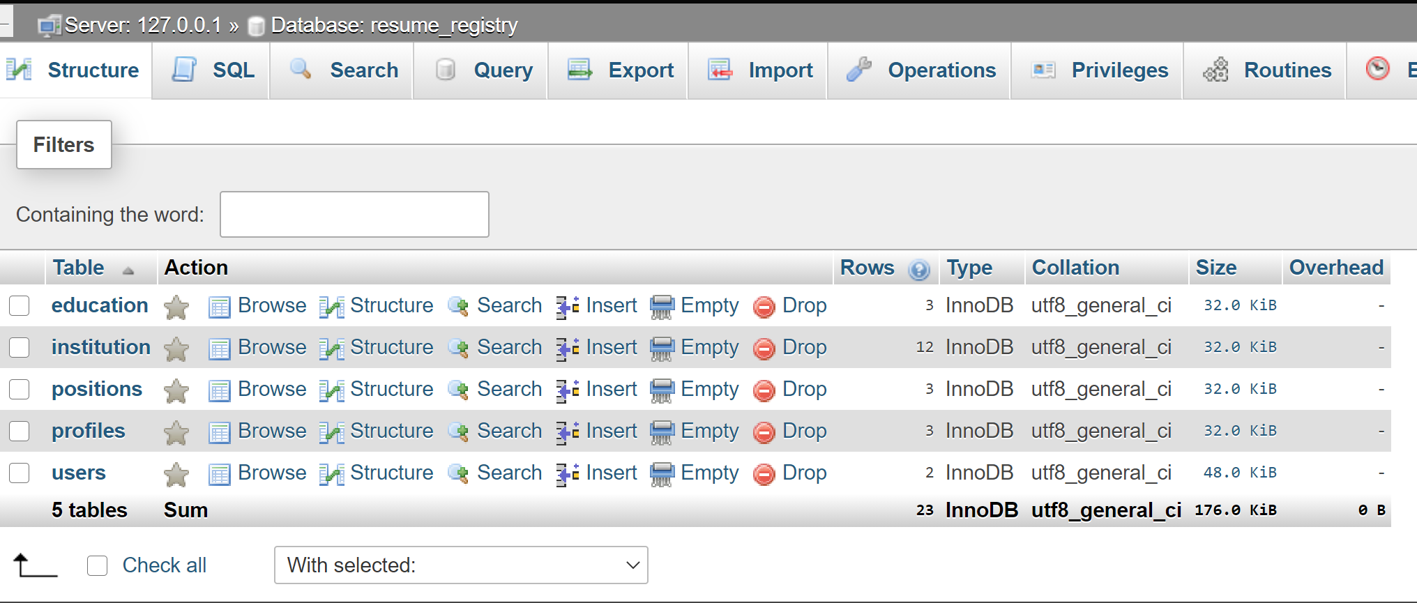
Implementation- Server Side
Database Instance:

Slide 10
Database connection and access using PHP PDO - fetch, prepare, execute
1.insert_profile($_SESSION['user_id'], $_POST['image_url'], $_POST['first_name'], $_POST['last_name'], $_POST['email'], $_POST['headline'], $_POST['summary']);
2. function insert_profile($uid, $img_url, $first_name, $last_name, $email, $headline, $sum) {
pdo_query_s(SQL_INSERT_NEW_PROFILE,
array(
':uid' => $uid,
':img' => $img_url,
':first' => $first_name,
':last' => $last_name,
':em' => $email,
':hl' => $headline,
':sum' => $sum ) );}

Slide 11
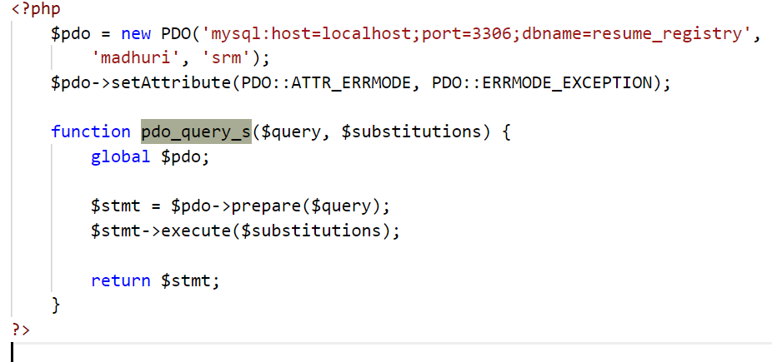
3. define('SQL_INSERT_NEW_PROFILE',
'INSERT INTO profiles (user_id, image_url, first_name, last_name,
email, headline, summary) VALUES (:uid, :img, :first, :last, :em, :hl, :sum)');

Slide 12
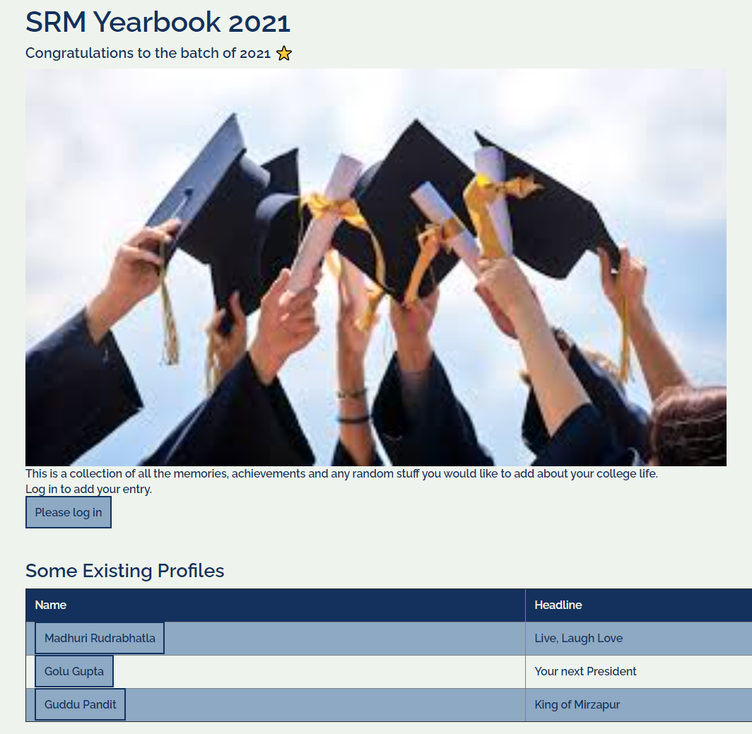
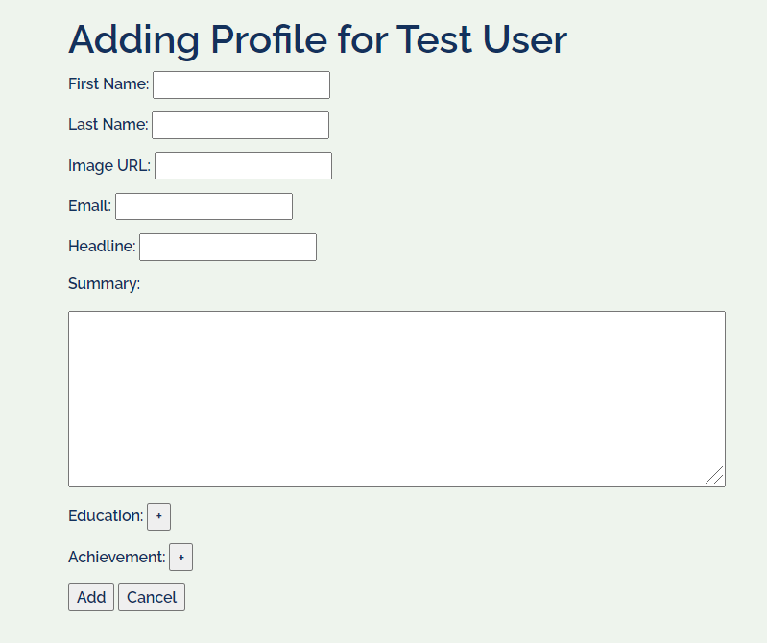
Screenshots: (Click Here for Demo Video)

Slide 13
Thankyou.

